Slide 1

Interpretable multi-variate time series forecast for vaccine demand prediction
Yan Sun
Georgia Institute of Technology
Merck USA

Slide 2
Contents
Introduction: interpretable time series forecast
Multivariate forecast
Current limitations
Methodology
Results
Conclusion
Acknowledgement

Slide 3
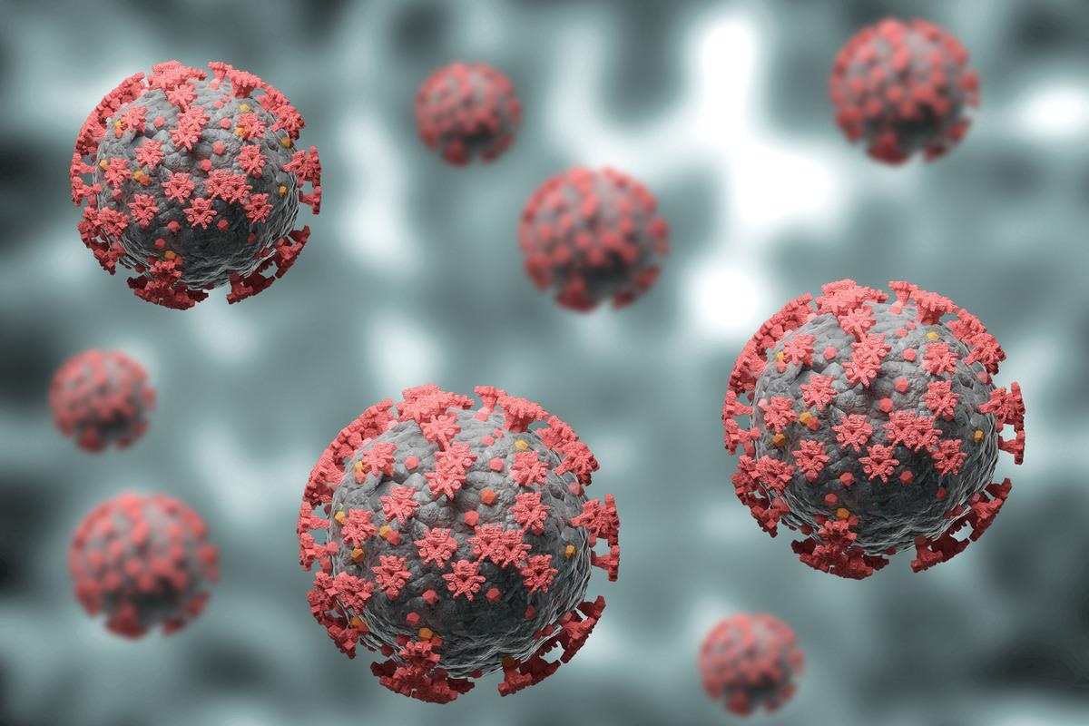
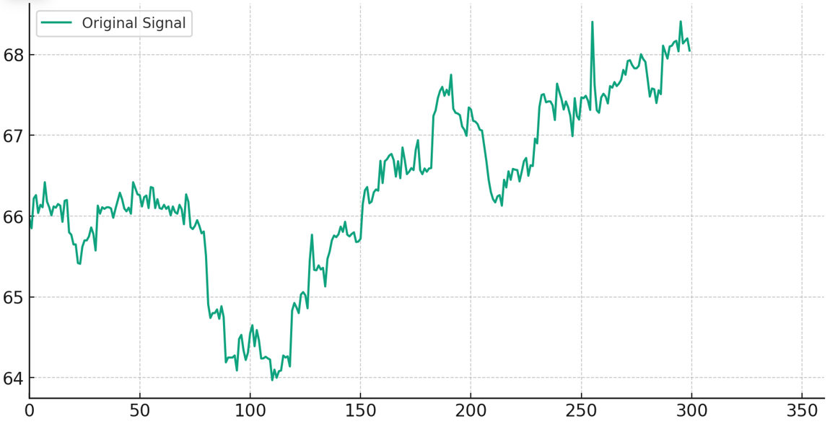
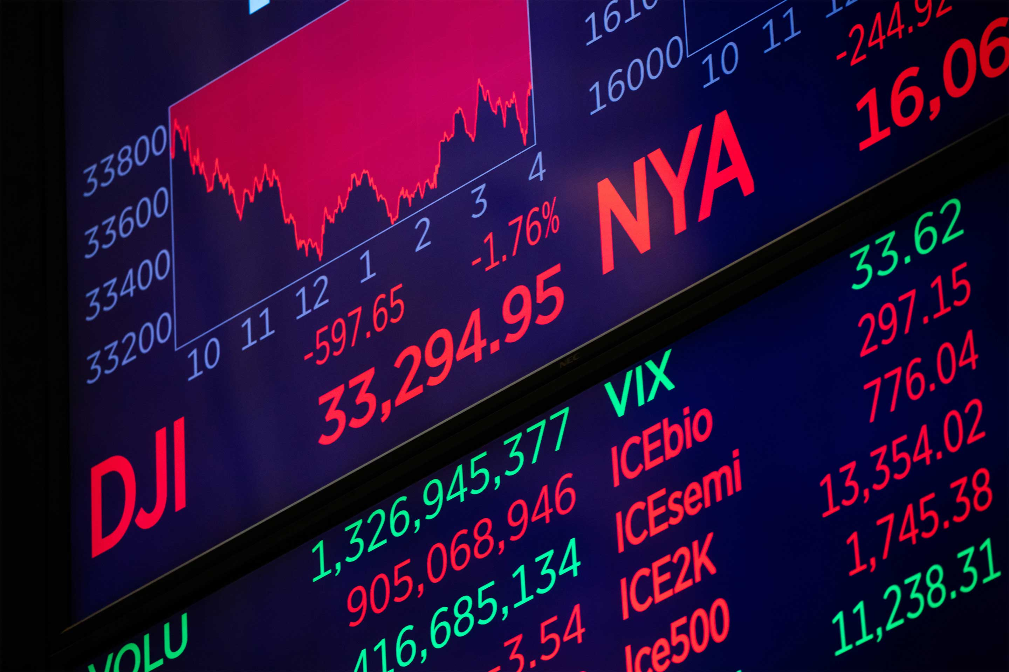

Use cases of interpretable time series analysis
Time series analysis seeks to predict time series in the future. But compared to some black-box deep learning technique, we are interested in the mechanisms inside it.
Disease prediction
?
Stock market
Manufacture forecast

Slide 4
Use cases of interpretable time series analysis
Time series analysis seeks to predict time series in the future. But compared to some black-box deep learning technique, we are interested in the mechanisms inside it.
Disease prediction
?
Stock market
Manufacture forecast

Slide 5

Use cases of interpretable time series analysis
Time series analysis seeks to predict time series in the future. But compared to some black-box deep learning technique, we are interested in the mechanisms inside it.
?
What is in the black box?

Slide 6
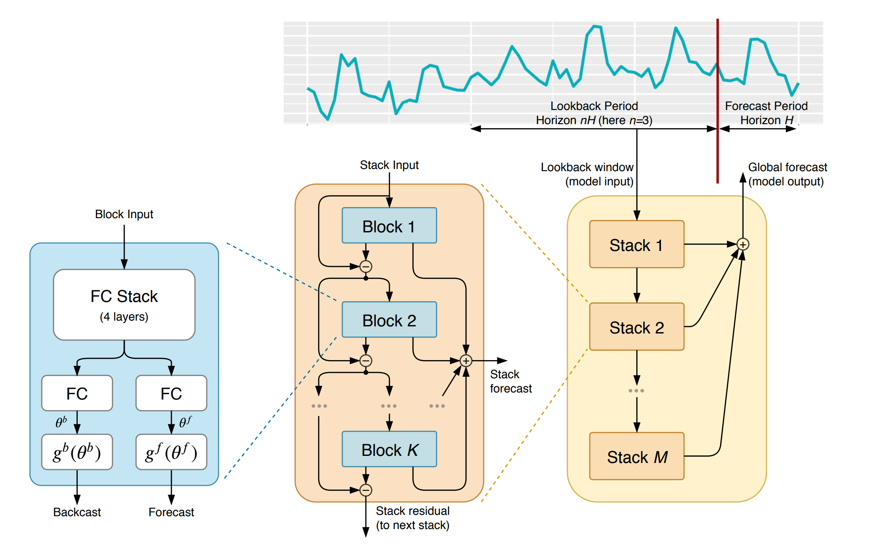
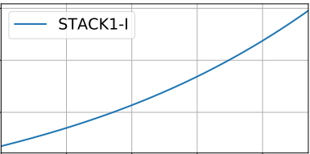
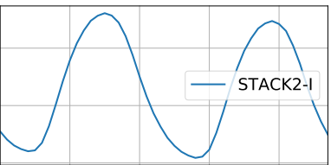
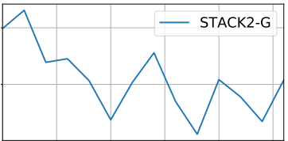
Interpretable time series analysis
Interpretable time series analysis seeks to predict time series from a trend-seasonality perspective, but in the form of deep learning technique.
Trend
Seasonality
High-frequency variability

Slide 7
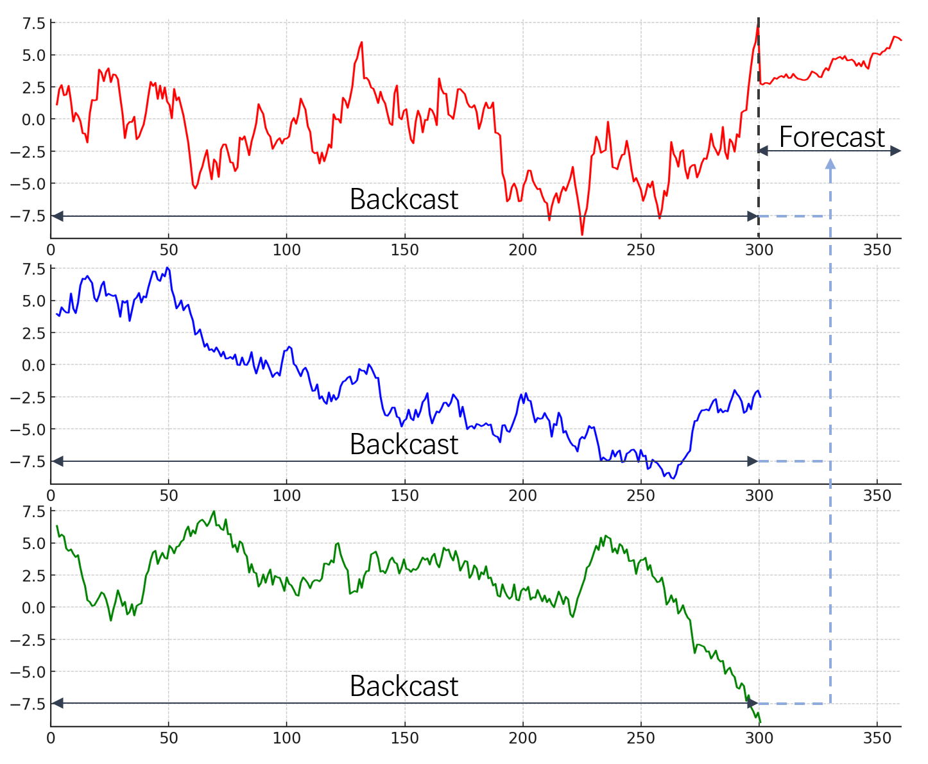
Multivariate time series analysis
In multivariate forecast scenarios, we are interested in enhancing prediction accuracy with information of other series. For example, the confirmed cases in COVID-19 can provide predictive information on the demand of vaccines.
Vaccine demands
Confirmed cases
Mobility index

Slide 8
Current limitations
Current methods achieve multivariate forecast tasks through tensor concatenation, which may lead to inaccurate decomposition and curse of dimensionality.
Concatenation

Slide 9
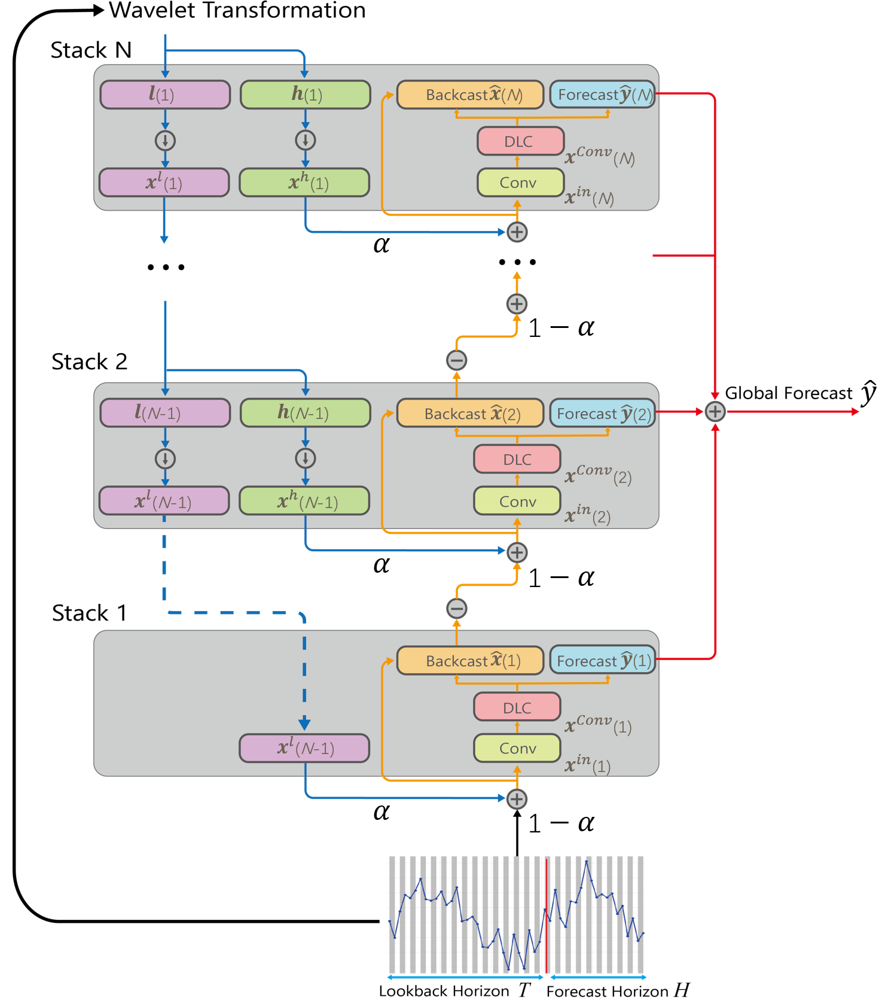
Methodology: wavelet decomposition (MDWD)
To address the issue of series decomposition issue, we infuse interpretability using multi-level wavelet decomposition to enforce each stack to focus on different patterns (trend, seasonality, etc.).

Slide 10
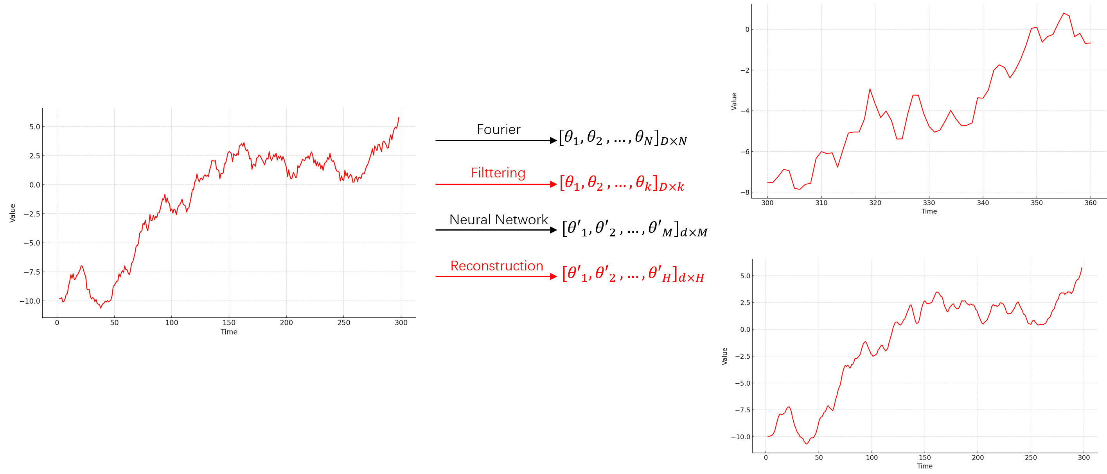
Methodology: Fourier reconstruction
To address high-dimensionality issue, we transform the model from original space to Fourier space and reconstruct the series using filtered Fourier coefficients. Such dimension reduction has been proven to be efficient for high dimensional problems.
Reconstructed series
Original data
Forecast

Slide 11
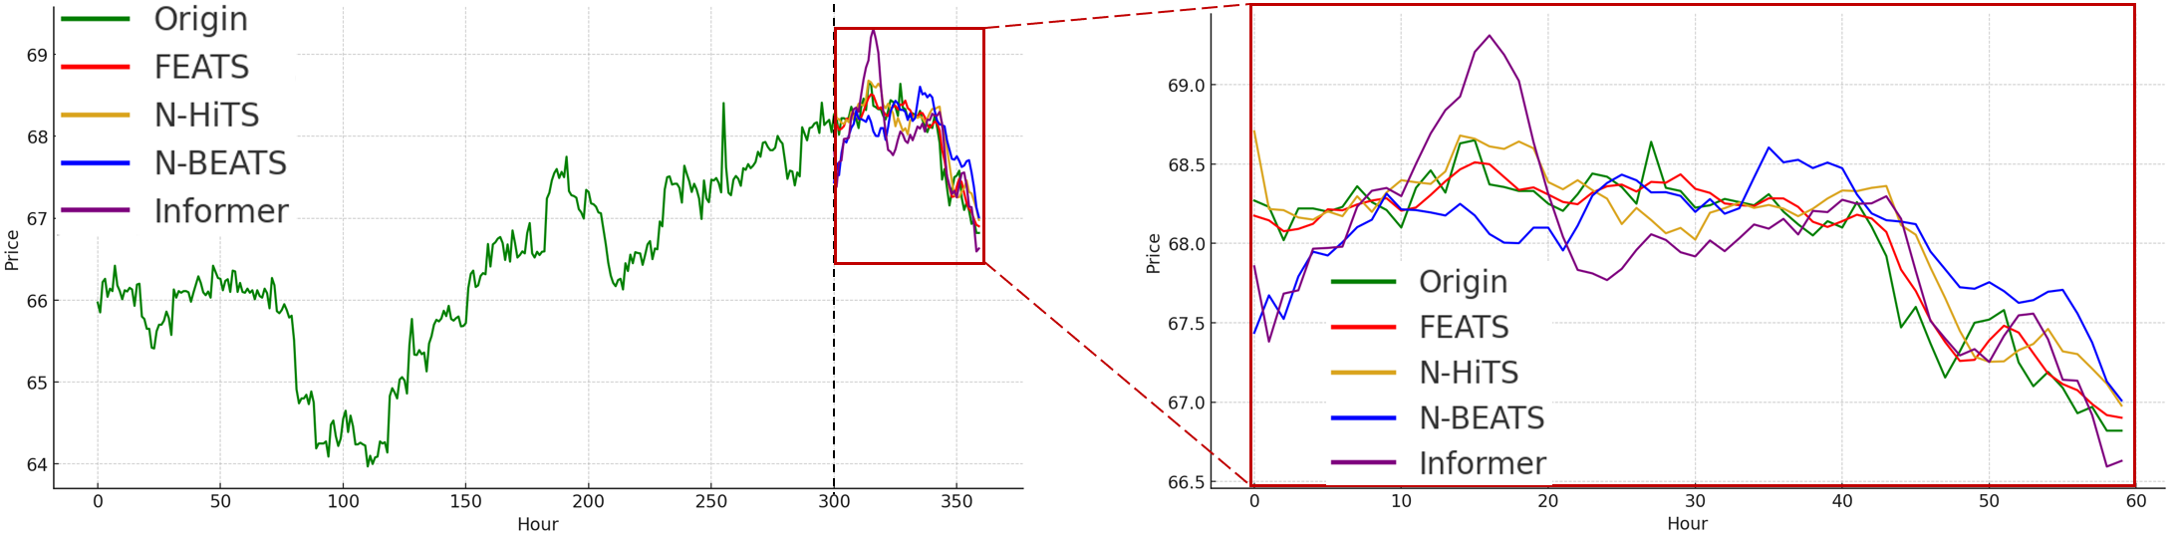
Results
We use a simulated multivariate dataset, which contains certain time series that is provides predictive information on the time series that we are interested in.

Slide 12
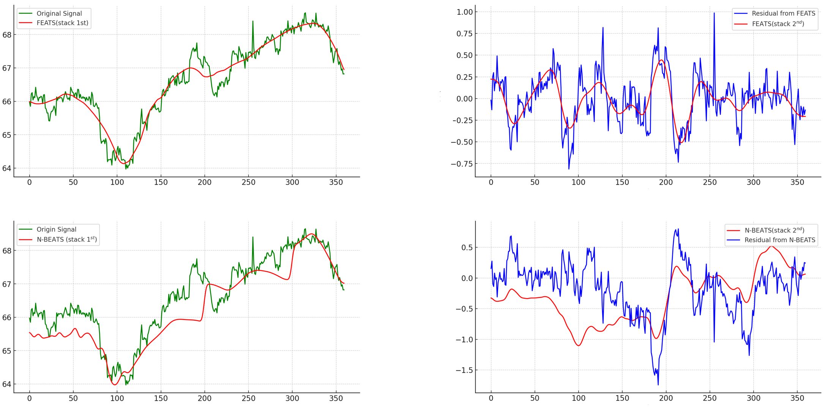
Results
We use a simulated high dimensional dataset generated by timeGAN, which contains certain time series that is provides predictive information on the time series that we are interested in.
Trend
Seasonality
Trend (N-BEATS)
Seasonality

Slide 13
Results (Con’d)
Result comparison with multiple benchmarks:
Dataset | Our model | N-BEATS | N-HiTs | Transformer
TimeGAN | 0.170 | 0.208 | 0.183 | 0.216
ETTm2 | 0.198 | 0.204 | 0.211 | 0.201
ECL | 0.294 | 0.306 | 0.315 | 0.367
Weather | 0.332 | 0.346 | 0.319 | 0.298
MSE comparison on several popular datasets

Slide 14
Application
Prediction of glass vial demands to facilitate manufacture, based on multiple data sources (confirmed cases, mobility rate index, etc.).
Prediction of mobile phone demands based on sales data, population data, and sales data from competitors.

Slide 15
Conclusions
High cell density culture of Pichia pastoris was achieved by fed-batch methods,
methanol-limited and oxygen-limited methods
Two substrates, glycerol and methanol were accurately monitored in real-time using on-line
bioprocess monitor
The monitor tracked critical substrate conditions such as peak concentration, depletion,
and consumption rate
The antibody titer in glycoengineered P. pastoris was highest at 10 g/L methanol
dosages in oxygen-limited fermentation
Bioprocess monitor was robust enough to continuously operate over 365 days
with no recalibration

Slide 16
Thank you!
Questions?
yan.sun11@merck.com

